Slide 1

Student Record Management System

Slide 2
INTRODUCTION
Full Stack Application – Student Record Management System
A Student management system is an application that is designed to manage all the functions of a Student. It helps staff to maintain the database of all the Student and the parents contact details. This system completely automates all your student activities.
The basic functions of student management include overseeing all student operations and managing data.

Slide 3
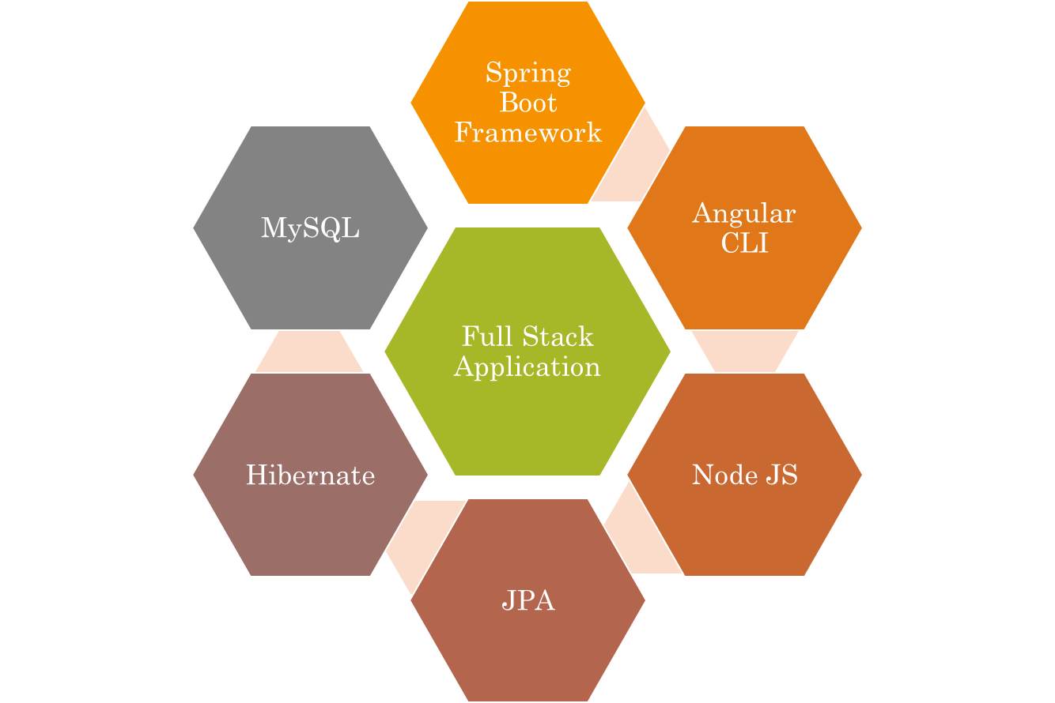
Technologies used.

Slide 4
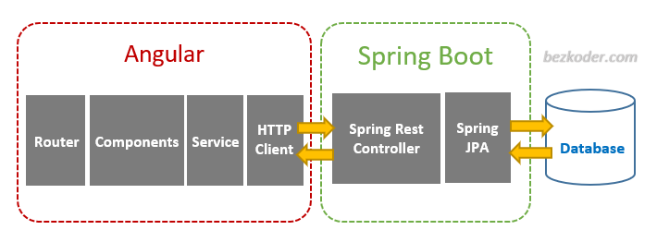
The Architecture of Angular, Spring & database(MySQL)

Slide 5
The Architecture of the Project
Angular JS
Node JS
Frontend
Spring Boot
Backend
MySQL

Slide 6
CRUD Operations
View Record
Update Record
Delete Student
CRUD
Add Student

Slide 7
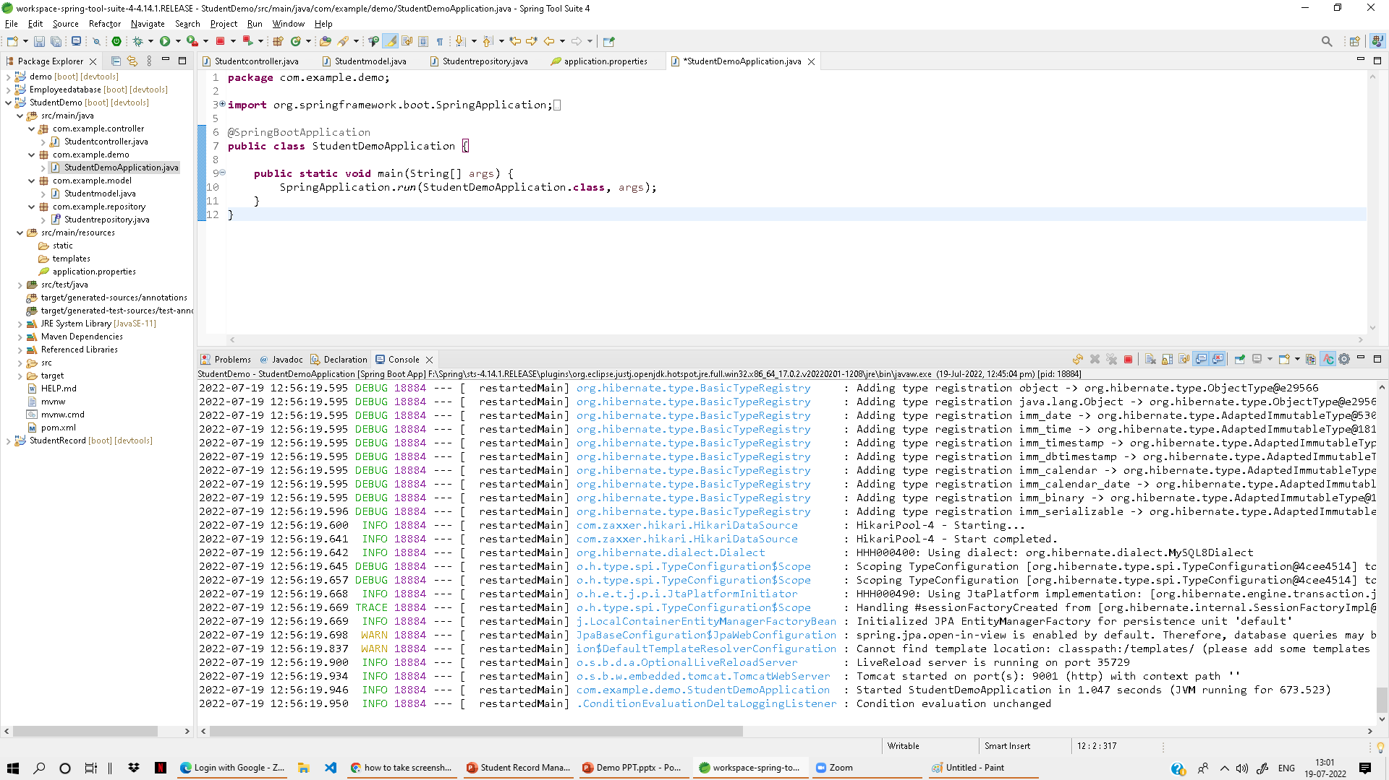
Spring Boot Application

Slide 8
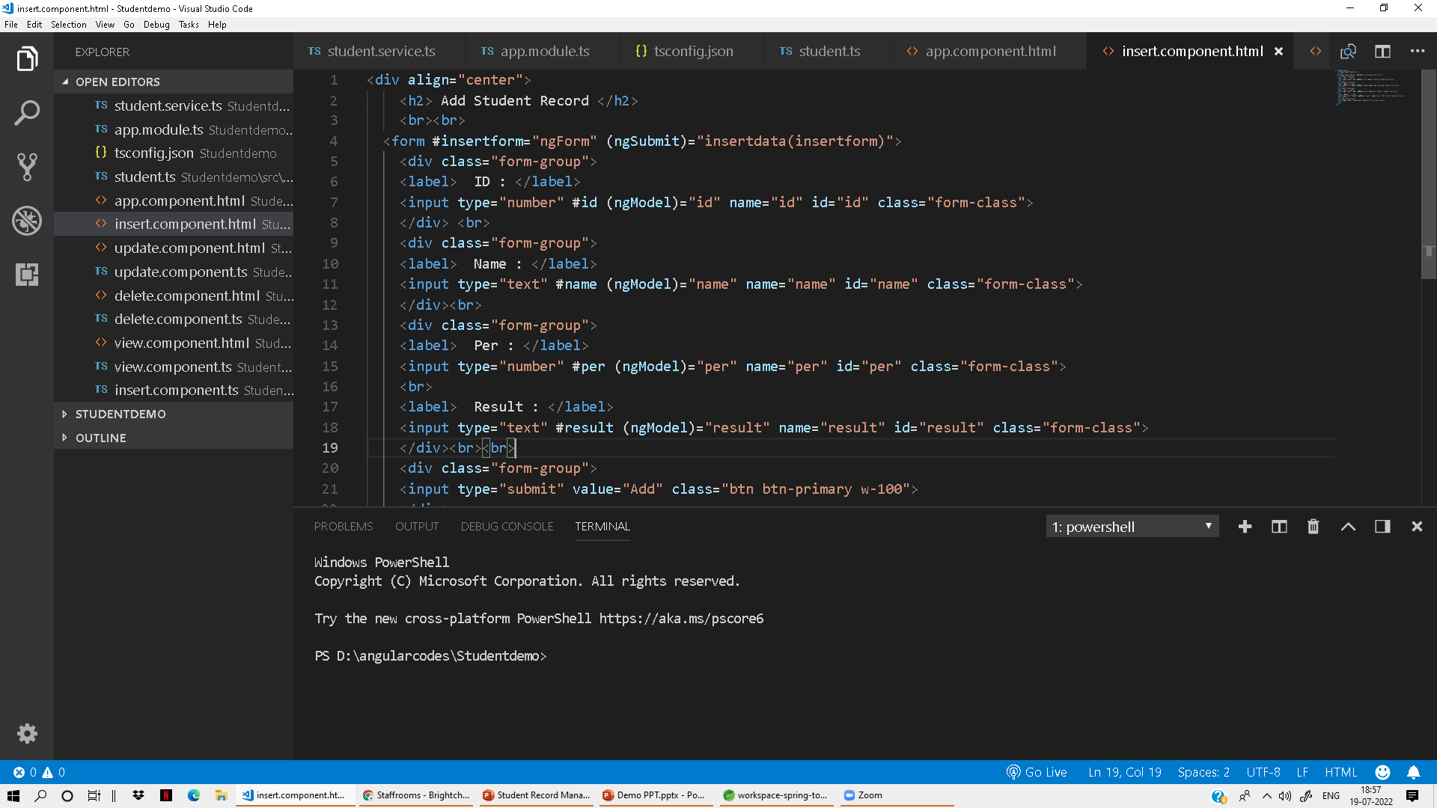
Frontend – Angular JS

Slide 9
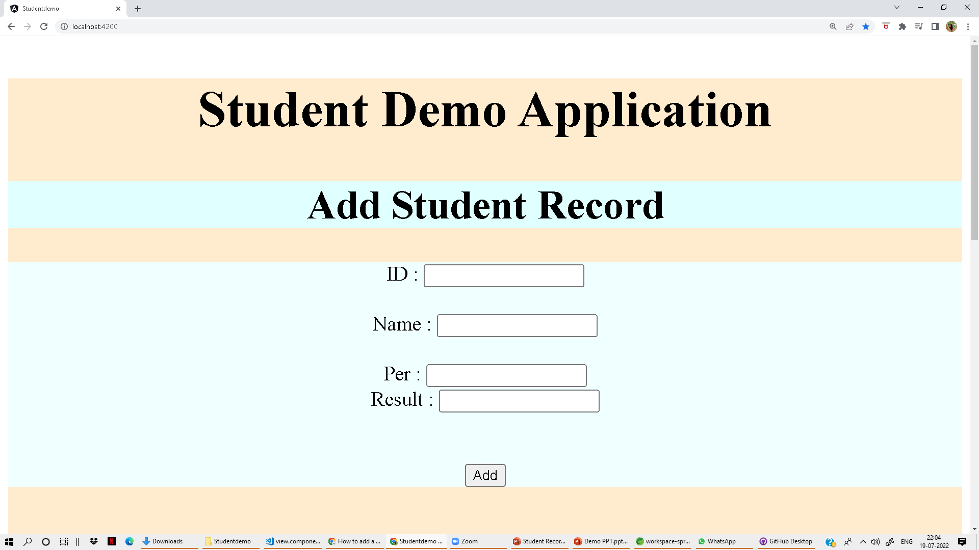
Add Page

Slide 10
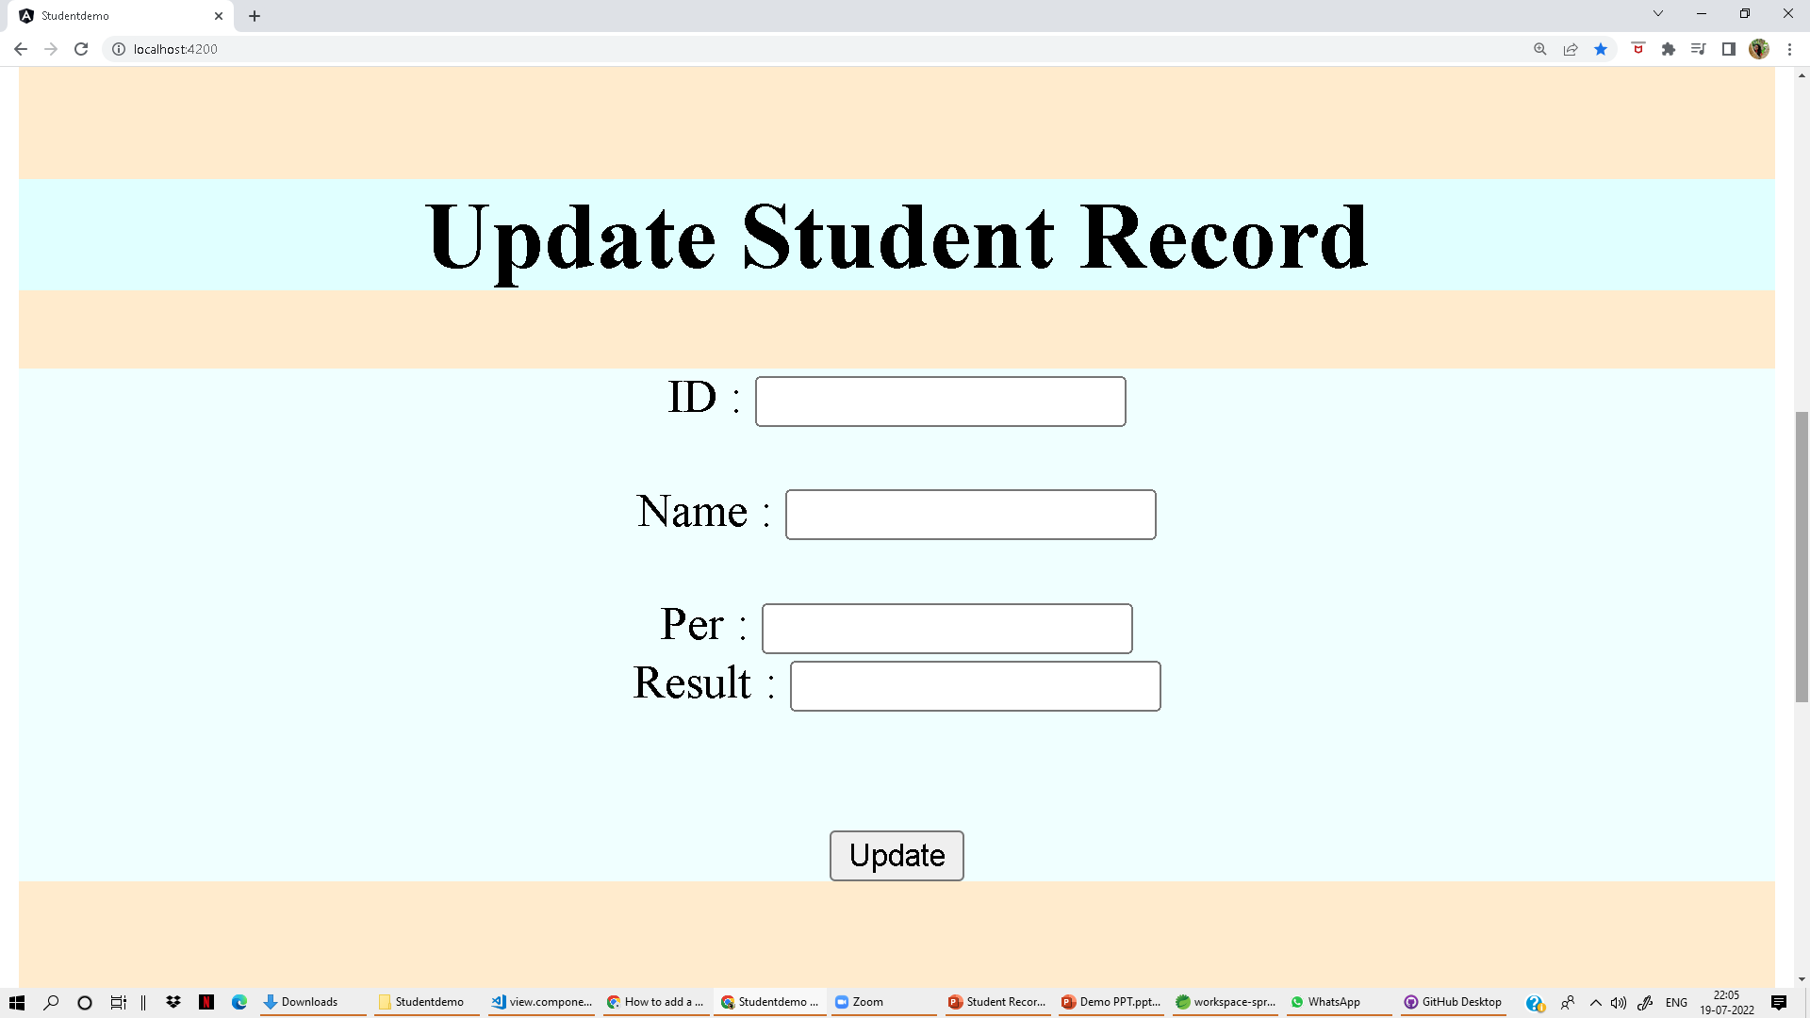
Update page

Slide 11
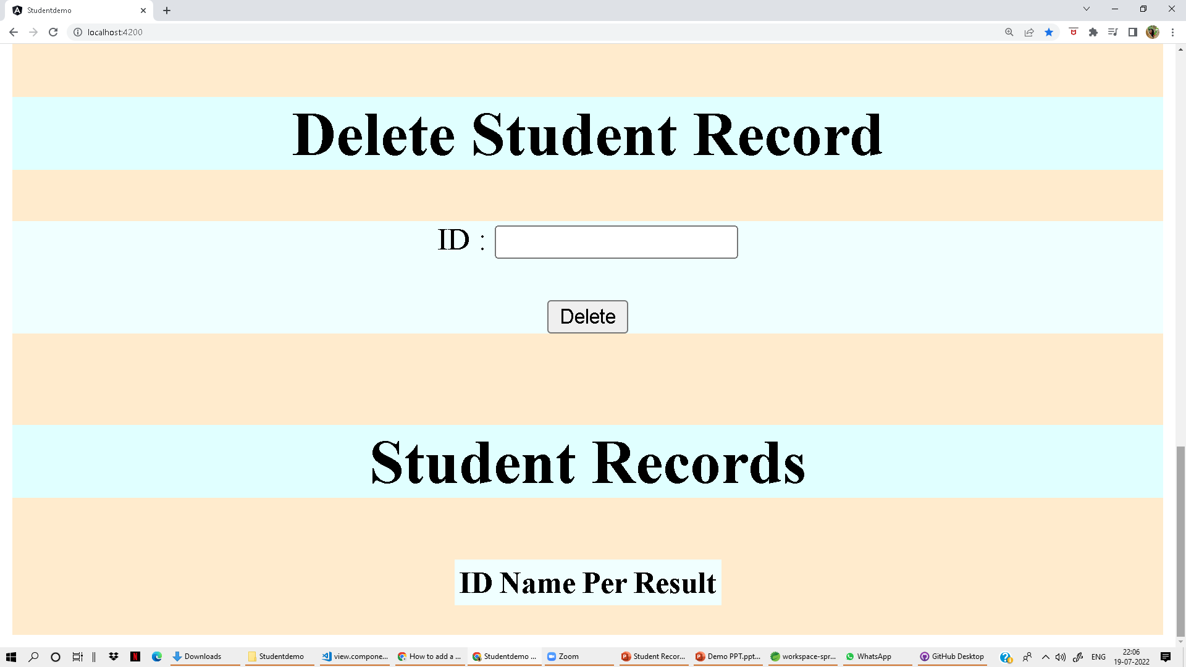
Delete and View Page

Slide 12

GitHub Link
GitHub - ChaitraNarasimhalu/StudentDemoo: Demo

Slide 13

Thank You

